Slide 1

11 JAN | 2021
Tiny (TEA) encryption & decryption
program
ECE311C-Microprocessor Course Project

Slide 2
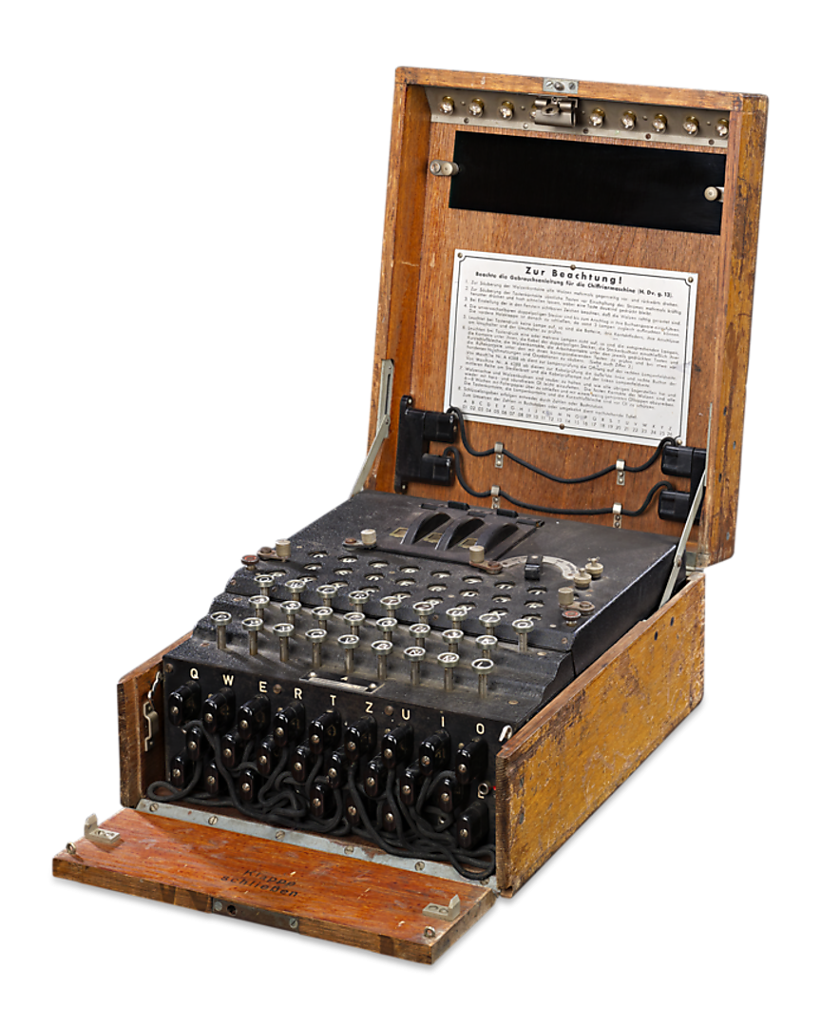

History
Before the modern era, security communication is the primary concern in government and military, As happened in the last century in the global war between the English and the Germans, the Enigma device was used to encrypt the messages of the German army generals.
Security communication become more important today as a result increasing use of the electronic communication for many daily activities such as internet banking, and online shopping.
01

Slide 3
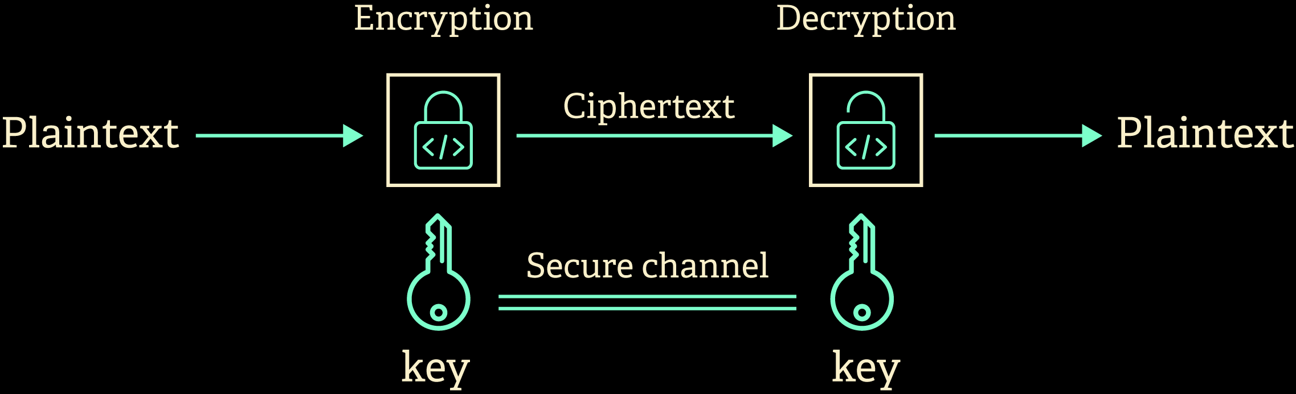
To establish secure communication, Transmitted data must be encrypted using cipher algorithms to prevent attacking it.
02

Slide 4
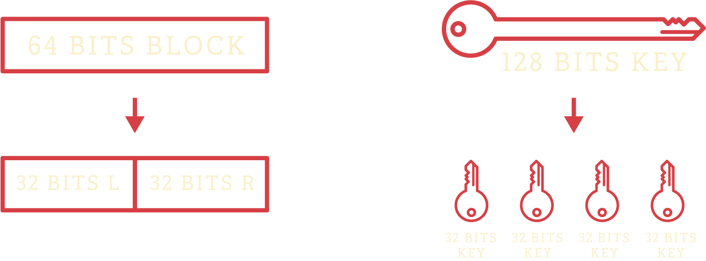
TEA - tiny encryption algorithm
Tiny Encryption Algorithm (TEA) is a block cipher was developed by David Wheeler and Roger Needham at the Computer Laboratory of Cambridge University and was first presented at the Fast Software Encryption workshop at Cambridge in 1994.
NUMBER OF ROUNDS = 32 ROUND
03

Slide 5
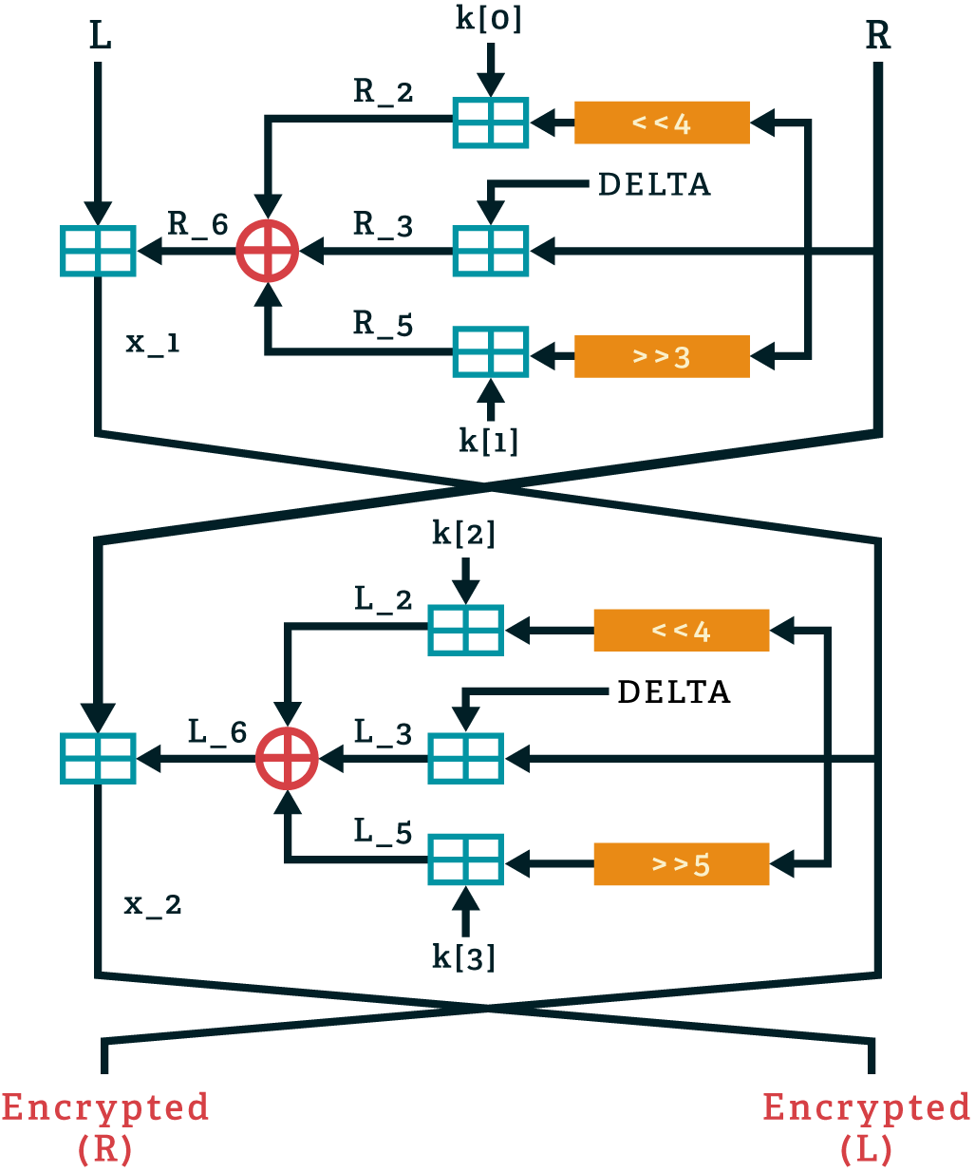
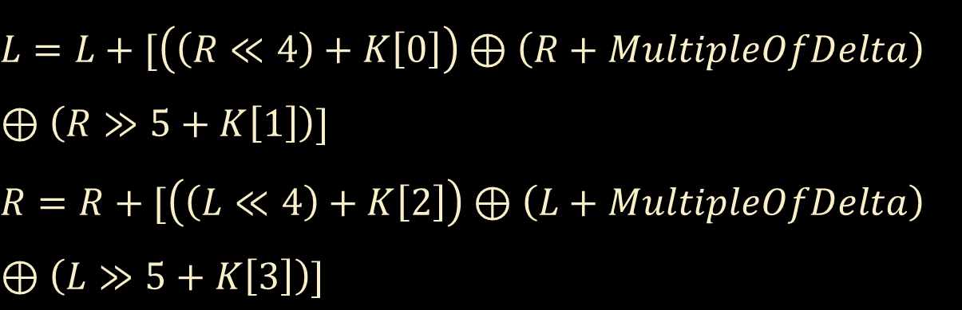
Encryption
ENCRYPTION ALGORITHM
$$L=L+[\left(\left(R≪4\right)+K\left[0\right]\right)⊕\left(R+MultipleOfDelta\right)$$
$$⊕\left(R≫5+K\left[1\right]\right)]$$
$$R=R+[\left(\left(L≪4\right)+K\left[2\right]\right)⊕\left(L+MultipleOfDelta\right)$$
$$⊕\left(L≫5+K\left[3\right]\right)]$$
Delta is a magic constant = 0x9e3779b9 simply serves to ensure that encryption in each round is different.
04

Slide 6
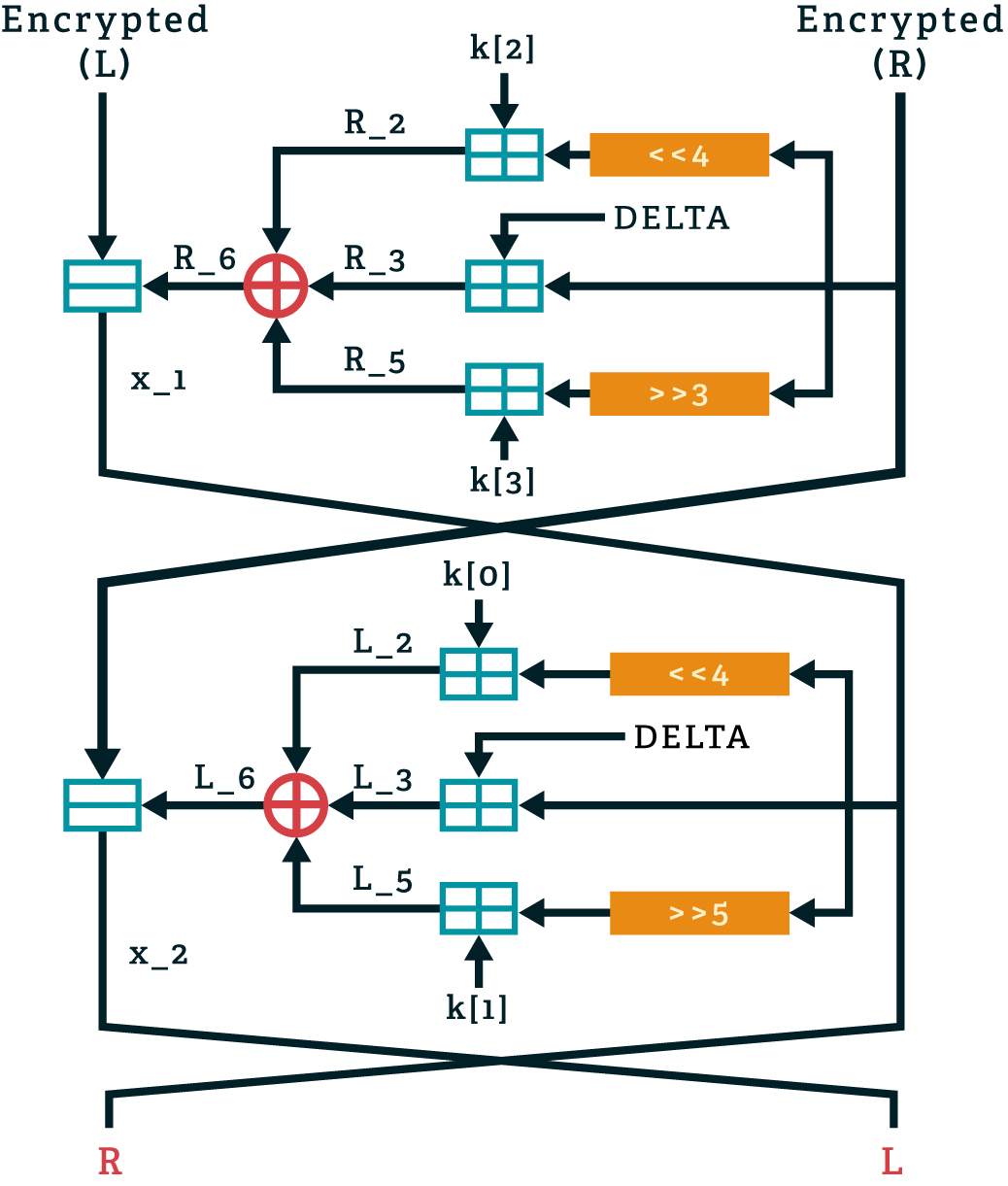
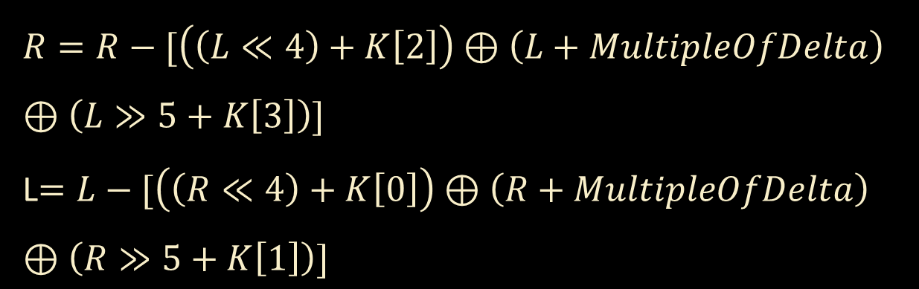
Decryption
DECRYPTION ALGORITHM
$$R=R−[\left(\left(L≪4\right)+K\left[2\right]\right)⊕\left(L+MultipleOfDelta\right)$$
$$⊕\left(L≫5+K\left[3\right]\right)]$$
L$=L−[\left(\left(R≪4\right)+K\left[0\right]\right)⊕\left(R+MultipleOfDelta\right)$
$$⊕\left(R≫5+K\left[1\right]\right)]$$
Delta is a magic constant = 0x9e3779b9 simply serves to ensure that encryption in each round is different.
05

Slide 7
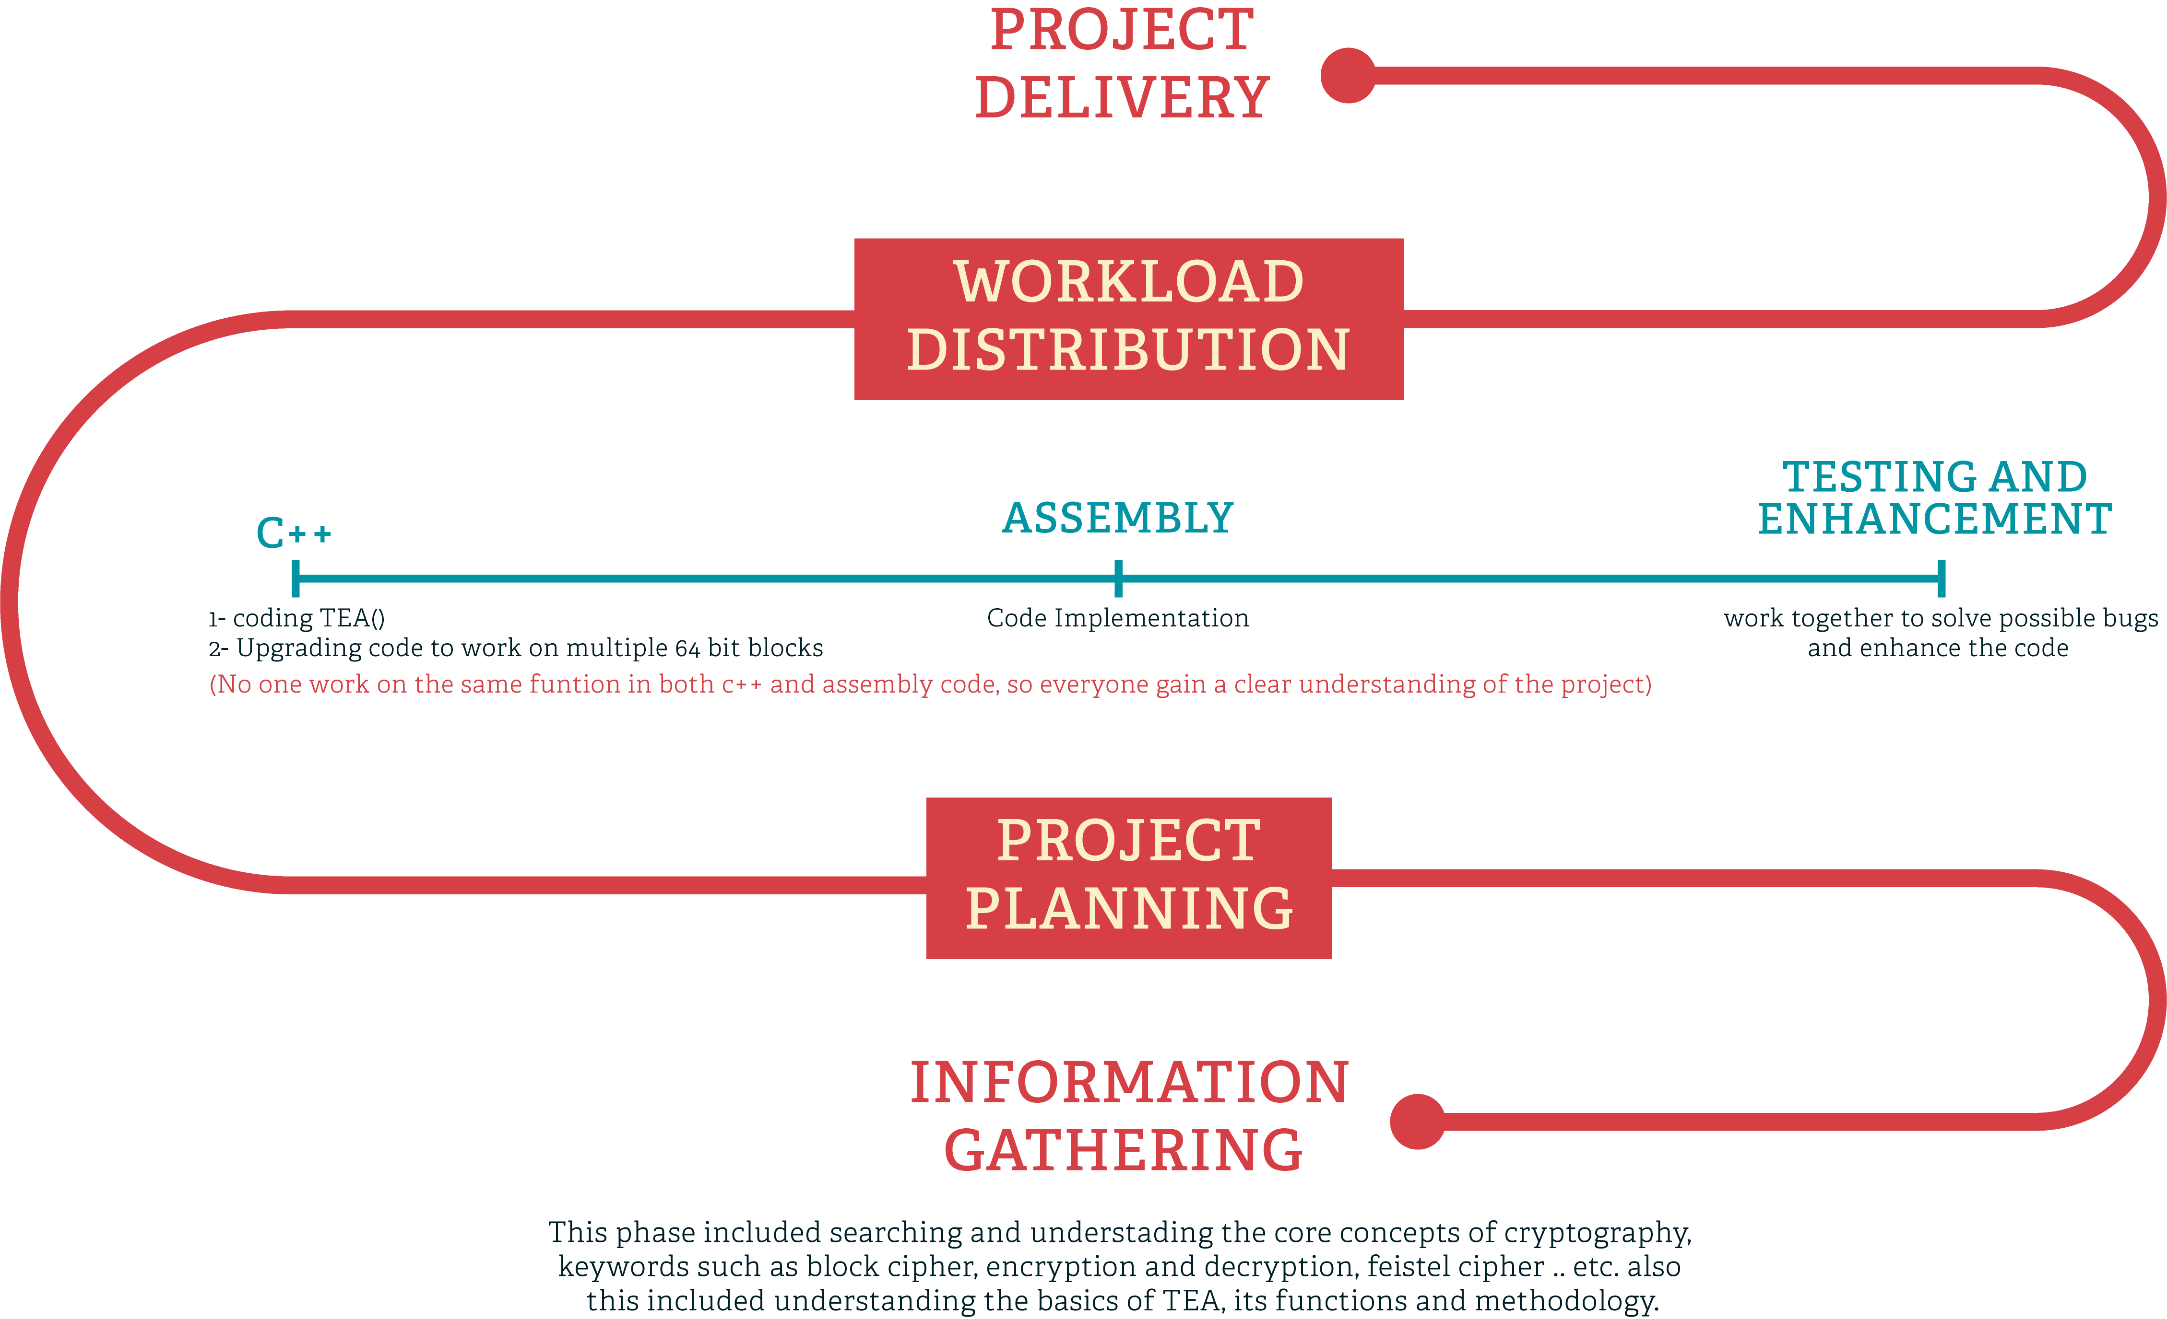
PROJECT PLANNING
06

Slide 8
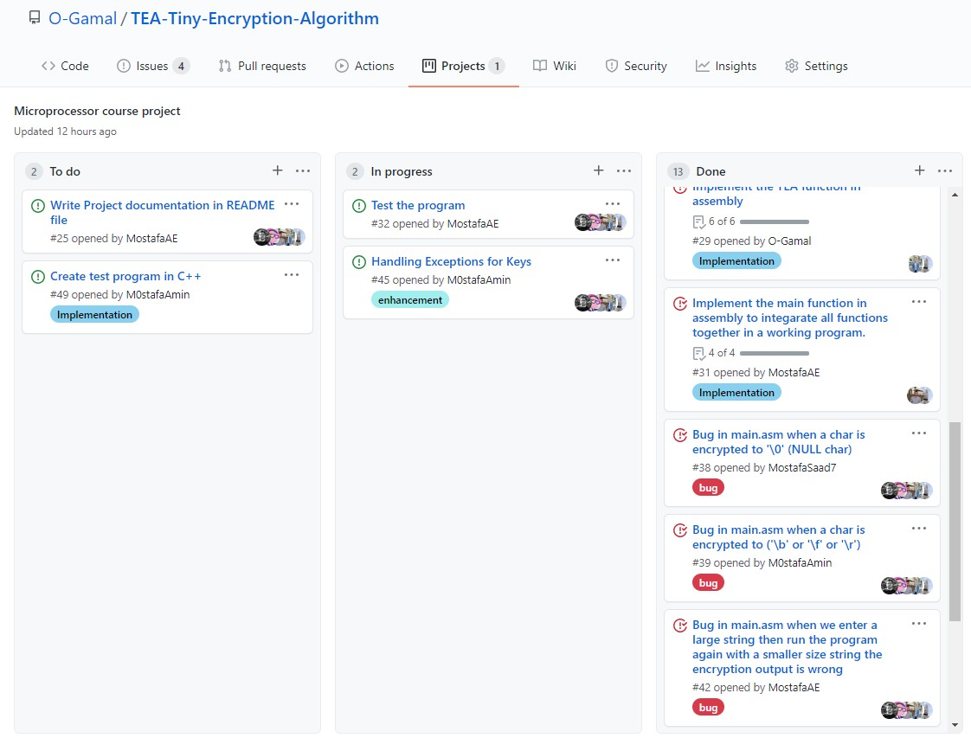
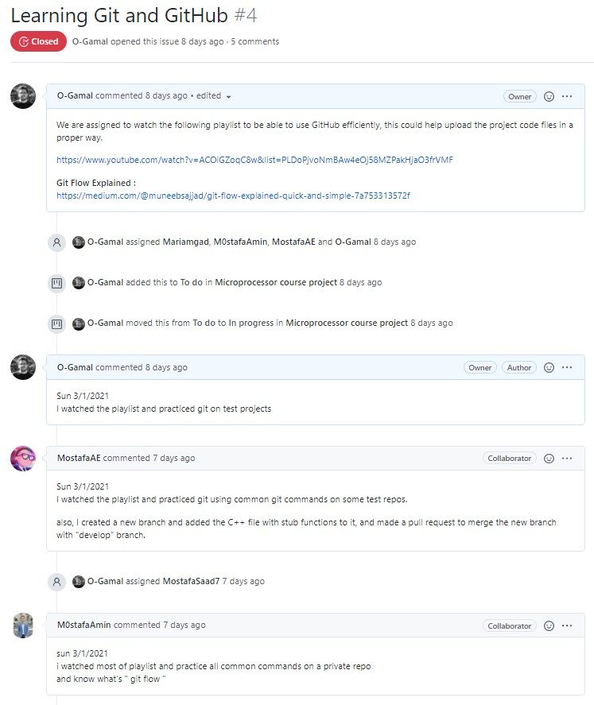
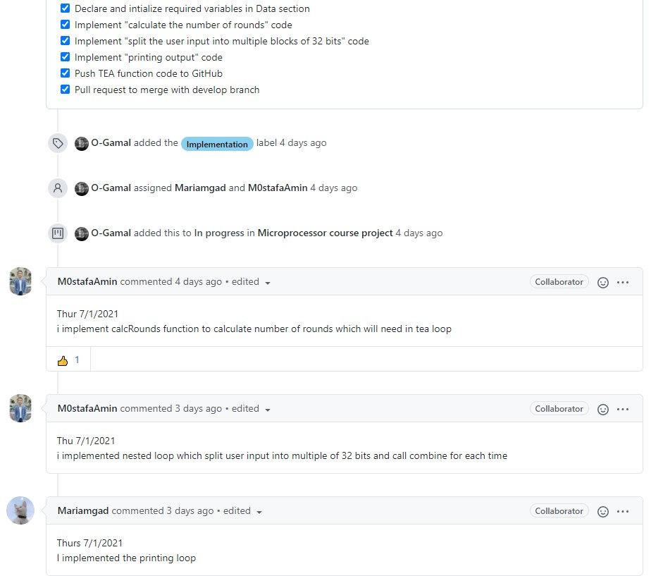
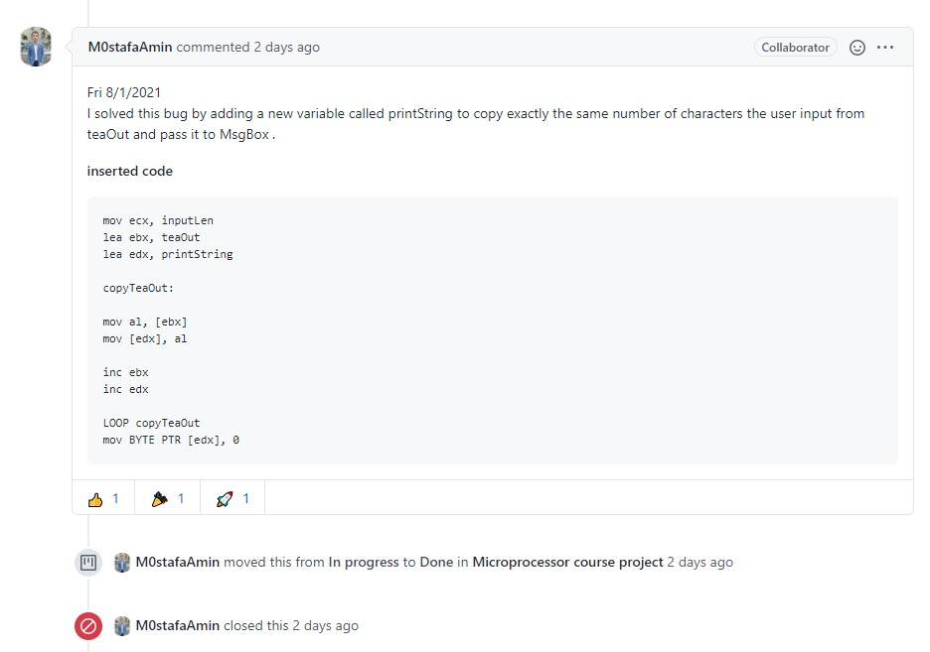
Planning
and work breakdown
07
Planning, Assigning tasks, Enhancement, and Solving bugs

Slide 9
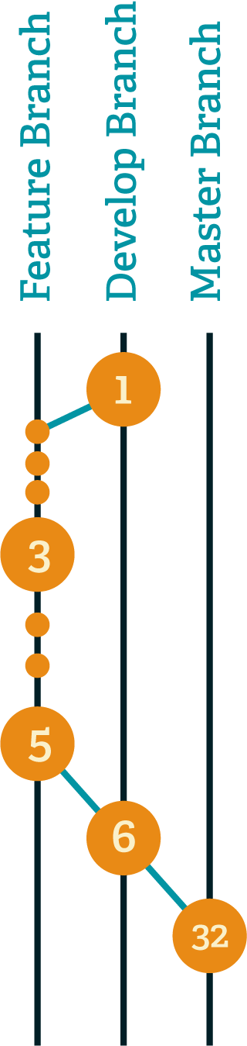
Planning
and work breakdown
GIT FLOW
Master Branch: represent the final product of project.
Develop Branch(default): Represent Latest delivered development changes (integration branch).
Feature Branches: created as per need once completed you can delete them.
Create feature branch to add new feature or solve a bug for the project
Make all changes (add or edit) on files ,make a commits (to keep track on that progress)
At the end of developing feature, create pull request to initiate discussion about the added commits
The leader merge it to develop when the feature has no conflict with develop branch
Delete feature branches when they are finished or discard them in case of bad experiment
08

Slide 10

We implemented TEA cipher which take input string [64-bit] in a high level language to simplify the functionality of cipher.
we implemented these four functions :
TEA
Encryption
Decryption
Combine
Split
Helper Functions
Then upgrade the code to work on multiple 64-bit blocks (More than 8 chars)
09

Slide 11
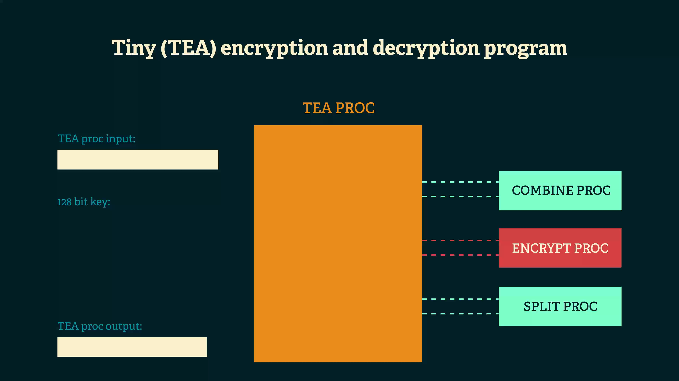

Slide 12
IMPLEMENTATION IN ASSEMBLY

Slide 13

This function combines every four characters in one integer.
The input is 8 chars so we need array of two integers
4 Chars = 1 integer (each character stored in one byte)
The first char assigned in first byte in integer, second assigned in second byte and so on
Now every integer represents half of the string

Slide 14

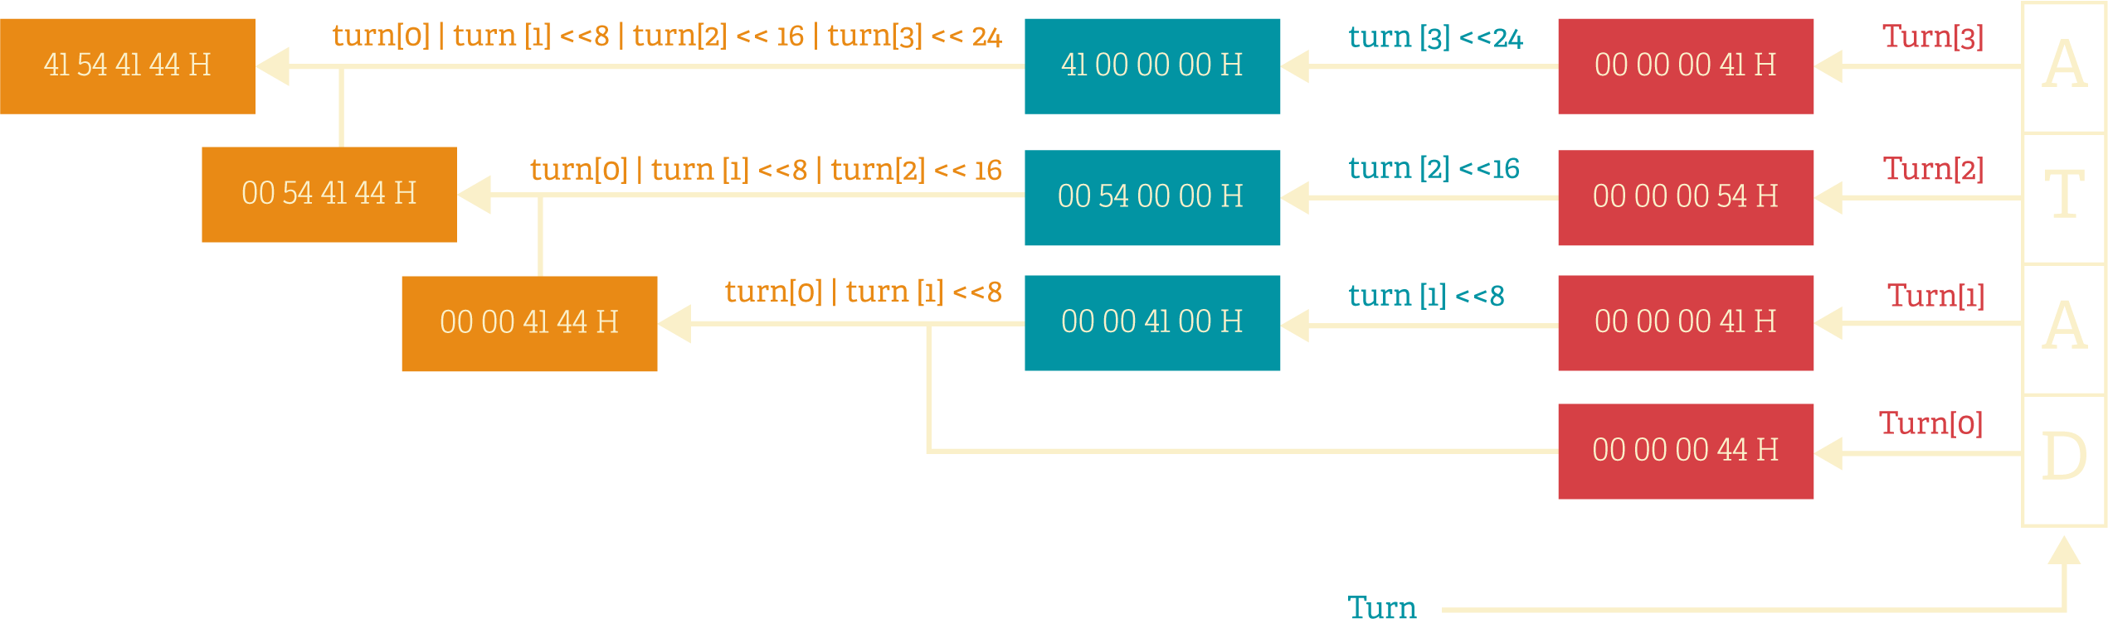

Slide 15
Encrypt:
This function uses 128-bit key (4 separated keys of int) and returned array of int from combine function
It operates 32 rounds on unsigned integers and uses a 128-bit key, mixing all of the key material
in exactly the same way for each cycle
Different multiples of a magic constant are used
to prevent simple attacks ,The magic constant delta we used is 0x9E3779B9

Slide 16
Decrypt:
The same steps are repeated with reversed keys

Slide 17


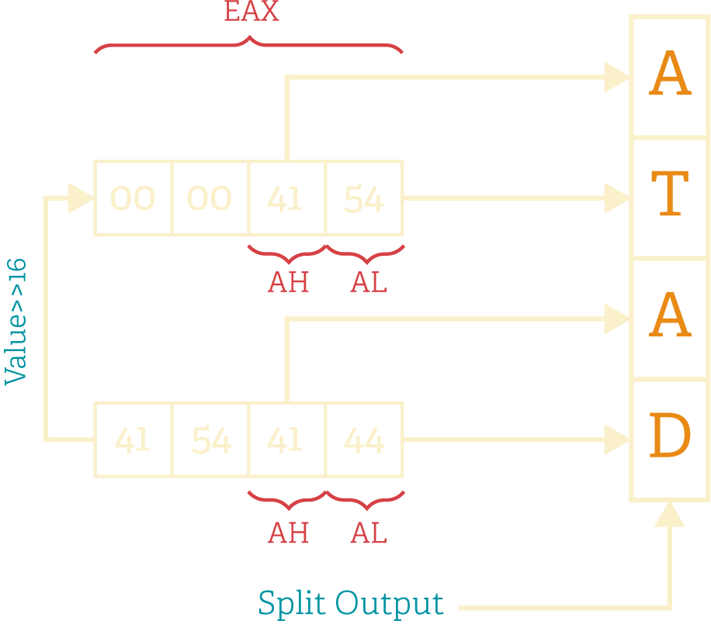
This function the reverse operation of combine.
It uses the returned array from encryption or decryption,
every 32-bit integer splitted into 4 chars.

Slide 18
UPGRADE CODE TO WORK ON MULTIPLE 64 BIT BLOCKS
Steps to implement this feature
Split the input into blocks of 8 chars
Iterate on each block to combine and generate 2 integers encrypt these integers
split the encrypted integers
store the encrypted text in a new string
This code works fine with a string of multiples of 8, other strings must be appended with (0x00).

Slide 19

UPGRADE CODE TO BE INTERACTIVE
Pop up message box
Message asks the user if he want to decrypt the text or not after printing the encrypted one
Message asks the user if he want to encrypt another text

Slide 20
TESTING
THE PROGRAM

Slide 21
TEST PLANNING
We will implement every unit (procedure) in a separate file, so we can test it individually first to expose as many defects as possible as early as possible.
After all units are implemented, we will integrate them together in a fully working program and run various test cases generated using some websites that generate random words like https://www.lipsum.com and https://randomword.com/paragraph.
After detecting and solving all the minor bugs if there is any, we will create a testing program using assembly, that compares the output of the TEA assembly program and the TEA C++ program.

Slide 22
Documentation for all the bugs we faced
After integrating all the units (Procedures) together
GitHub Issue:
Test the program #32

Slide 23
Bug Description
Bug Status
SOLVED
Bug in main.asm when a char is encrypted to '\0' (NULL char)
#38
Bug in main.asm when a char is encrypted to ('\b' or '\f' or '\r')
#39
Bug in main.asm when we enter a large string then run the program again with a smaller size string the encryption output is wrong #42
Bug in main.asm when we present the output in Message Box, sometimes the output result is wrong when a character is en- crypted to '\0' (NULL char) #43
Bug in main.asm when we enter a large string then enter another string with lower size the encryption outputs wrong values #47
SOLVED
SOLVED
SOLVED
SOLVED

Slide 24
ASSEMBLY TESTING PROGRAM
After solving all the bugs we have faced after integrating all the procedures together, we decided to create a testing program using Assembly that compares the TEA assembly program output with the expected output automatically, instead of comparing the program output and the expected output character by character using our eyes.

Slide 25

IMPLEMENTATION OF THE ASSEMBLY TESTING PROGRAM
We have made a testing version of the TEA assembly program and the TEA C++ program that have the feature to read the test cases from a file and write the encryption and decryption output to an output file.
We have made an Assembly program to compare the output of both the TEA assembly program and the TEA C++ program character by character, and print the following:
The line number that caused an error The test status

Slide 26
GITHUB PROJECT LINK
https://github.com/O-Gamal/TEA-Tiny-Encryption-Algorithm

